Slide 1
List exercises

Slide 2
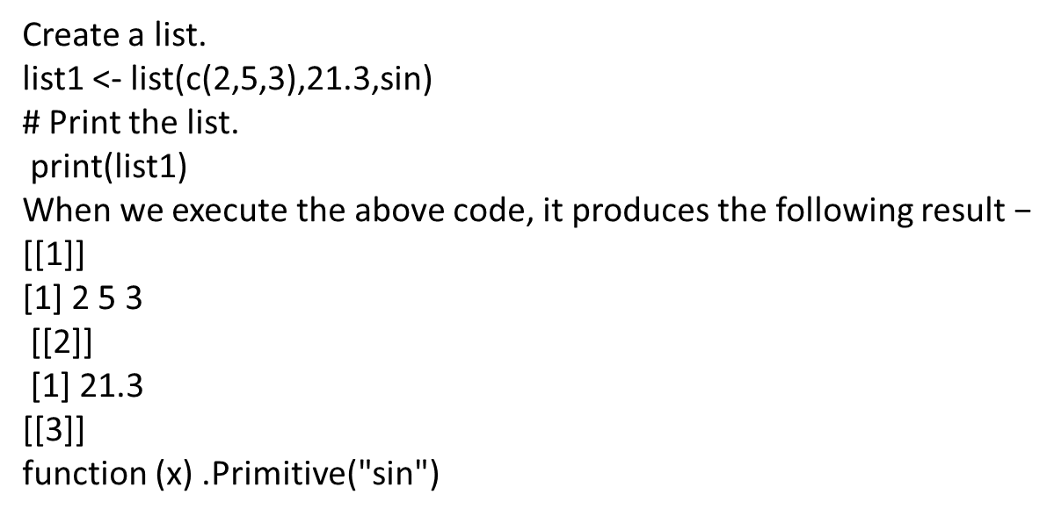
Write a R program to create and print list

Slide 3
Write a R program to create a list containing strings, numbers, vectors and a logical values.
list_data = list("Python", "PHP", c(5, 7, 9, 11), TRUE, 125.17, 75.83) print("Data of the list:")
print(list_data)
Sample output
[1] "Data of the list:"
[[1]]
[1] "Python"
[[2]]
[1] "PHP"
[[3]]
[1] 5 7 9 11
[[4]]
[1] TRUE
[[5]]
[1] 125.17
[[6]]
[1] 75.83

Slide 4
Write a R program to create and print first and second element of list
print(list1[1])
print(list1[2])

Slide 5
Write a R program to create a list, and add element at the end of the list.
list1=list(10.5,"beautiful",c(10,20,25))
print(list1)
list1[4]=25
print(list1)

Slide 6
Write a R program to create a nested list,
l=list(list(0,1),list(10,20),list(34,24))
print(l)
output
[1]]
[[1]][[1]]
[1] 0
[[1]][[2]]
[1] 1
[[2]]
[[2]][[1]]
[1] 10
[[2]][[2]]
[1] 20
[[3]]
[[3]][[1]]
[1] 34
[[3]][[2]]
[1] 24

Slide 7
Write a R program to merge two given lists into one list.
n1 = list(1,2,3)
c1 = list("Red", "Green", "Black")
print("Original lists:")
print(n1)
print(c1)
print("Merge the said lists:")
mlist = c(n1, c1)
print("New merged list:")
print(mlist)

